Slide 1
Microservices and DevOps
DevOps and Container Technology
Scientific Process
Henrik Bærbak Christensen

Slide 2
Scientific Process
The only difference between screwing around and science is writing it down!
- Andy Savage / MythBusters
Apply Science in your work!
(Most likely, you will need what you’ve written down at the final individual exam)

Slide 3
Scientific Process
Observation
Observation
How does system behave?
Hypothesis
Improve/correct by doing X
Experiment
Execute
Conclusion
Hypothesis is
Detailed Record Keeping!
To avoid getting lost! To track progress! To be reproducible!
Detailed Record Keeping
Experiment
Hypothesis
TRUE:
Refine Hypo.
FALSE:
Alt. Hypo.
Finding
Theory

Slide 4
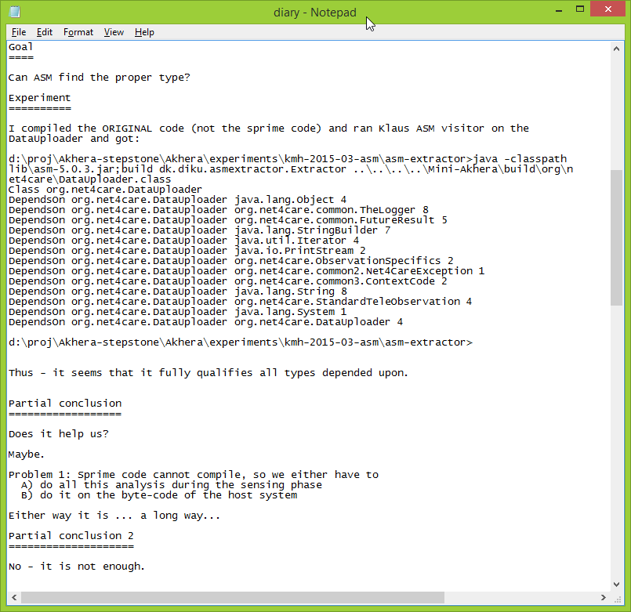
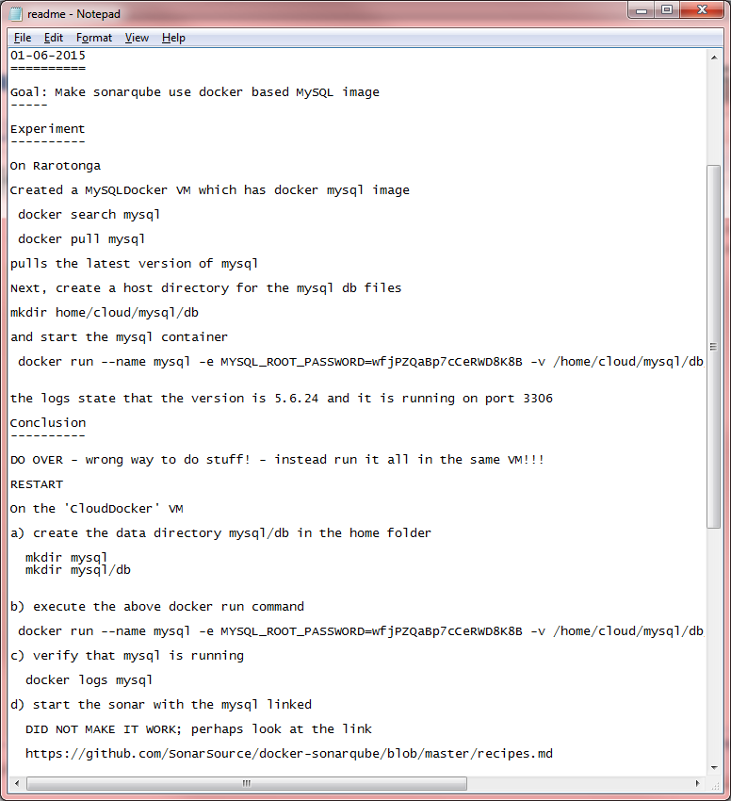
Example: Experiments
Keep the diary/logbook/journal at hand! Make notes!
Goal, hypothesis, experiment, conclude [loop]
Tool evaluation for Akhera
SonarQube setup for CloudArch Auto eval

Slide 5
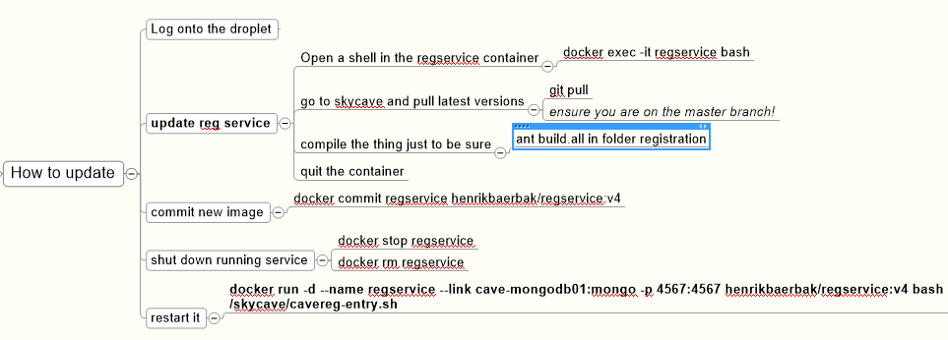
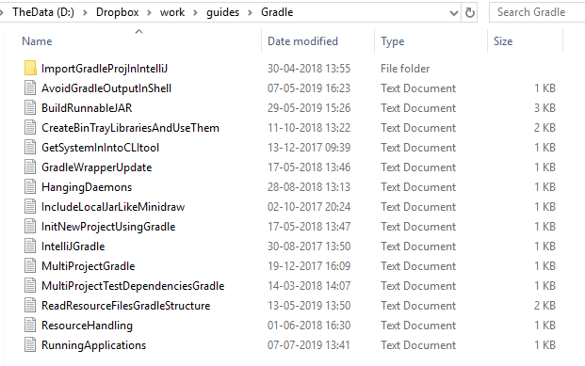
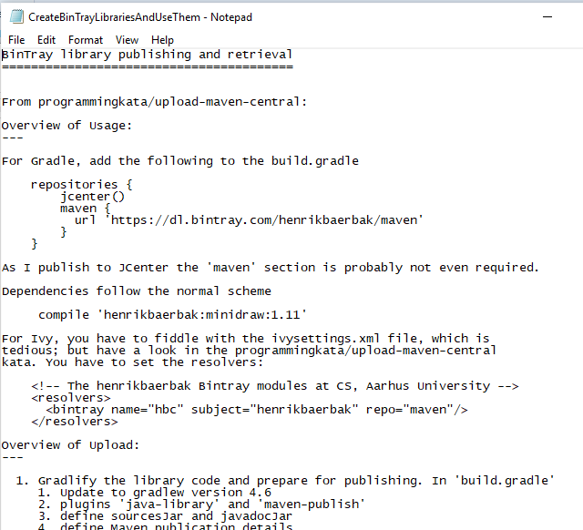
Example: Guides (Conclusions)
Update the Cave Subscription service (2016 version)
All that Gradle stuff…

Slide 6
A note
Detailed record keeping saves your sanity!
Christmas vacation: MQ update lead to total reinstall
Guides helped me reestablish full working environment
Extending Mongo DB disks
Involves repeating 10-15 steps in three differently configured machines
And a wrong step may crash 6 TB data ☹

Slide 7
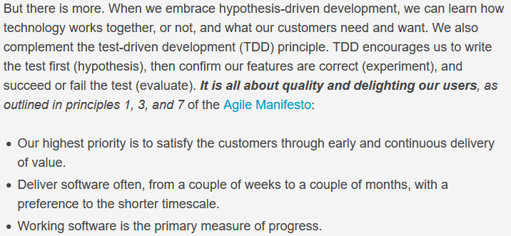
Test-Driven-Development
Is basically a natural science process
Reed, 2019

